Slide 1
FLIGHT PRICE PREDICTION

Slide 2
1. Problem Definition:
Anyone who has booked a flight ticket knows how unexpectedly the prices vary. The cheapest available ticket on a given flight gets more and less expensive over time. This usually happens as an attempt to maximize revenue based on –
1.Time of purchase patterns (making sure last-minute purchases are expensive)
2. Keeping the flight as full as they want it (raising prices on a flight which is filling up in order to reduce sales and hold back inventory for those expensive last-minute expensive purchases) So, you have to work on a project where you collect data of flight fares with other features and work to make a model to predict fares of flights.

Slide 3
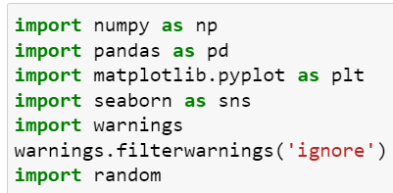
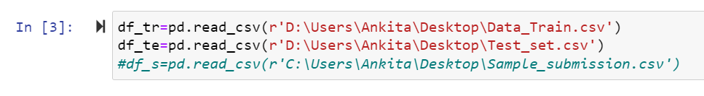
Dataset:
Here there are two dataset was present train dataset and test dataset

Slide 4
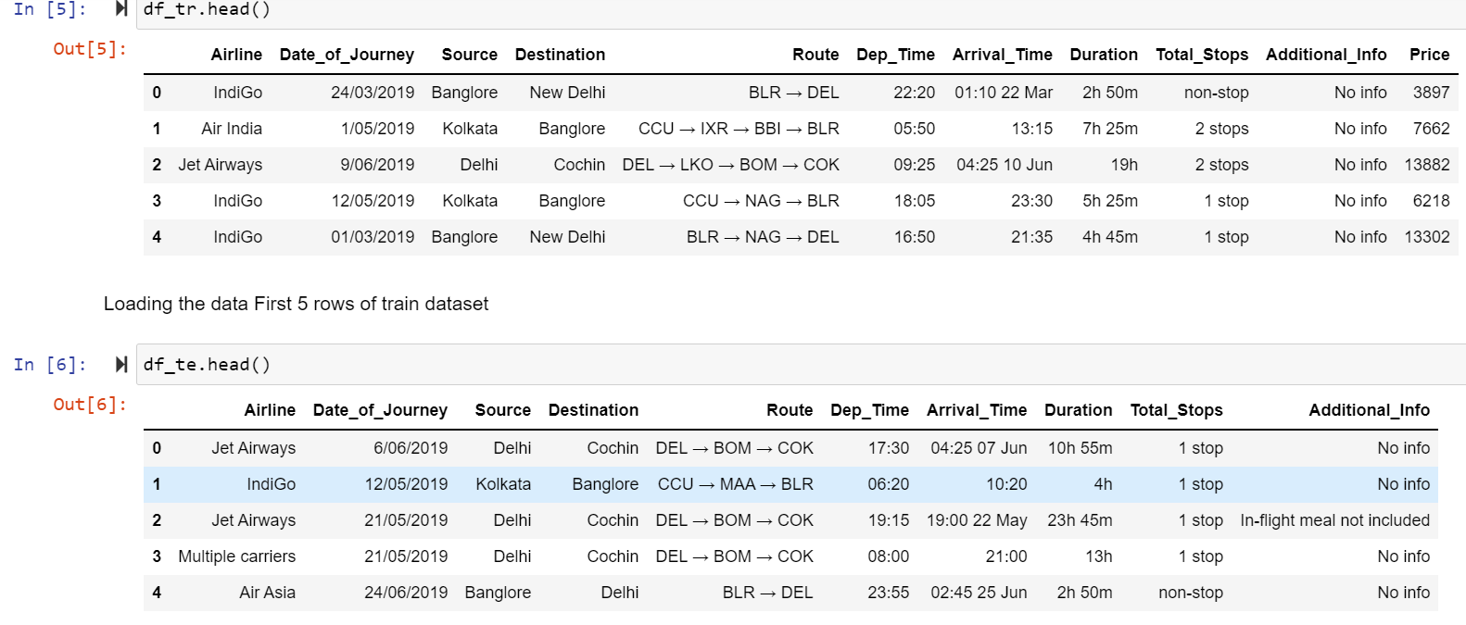

Slide 5
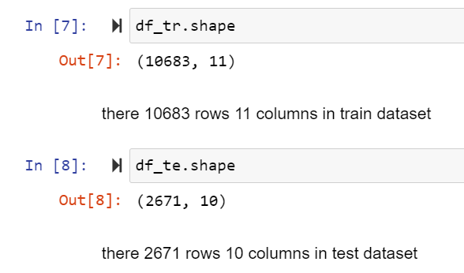
2. Data Analysis:
Check the how many Rows and Columns present in dataset:
Check the how much Columns and rows present in dataset using df.shape() is use to check the rows and columns count in this above dataset there are 10683 rows and 11 columns are present in train dataset and 2671 rows and 10 columns are present in test dataset.

Slide 6
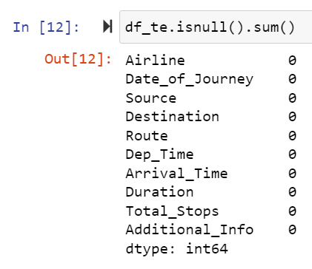
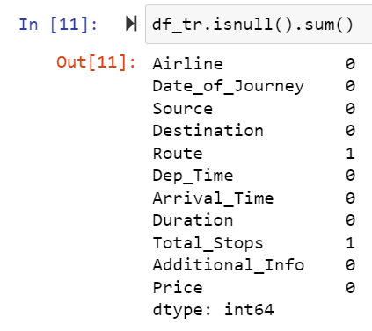
Check the null values present in dataset or not:
Check the how much missing values present in dataset using df.isnull() is use to check the missing values in dataset in this dataset there are 2 columns missing values are present and no missing are present in test dataset.

Slide 7
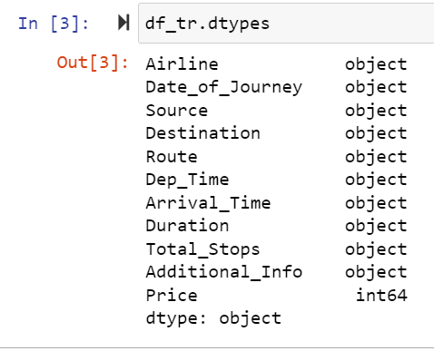
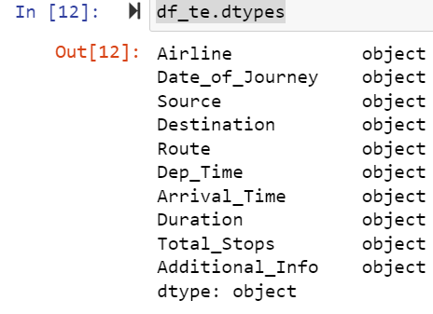
Here we check the datatypes of all the columns in dataset :
In above code df.dtypes is used to check the data types of all the column In above train and test dataset.

Slide 8
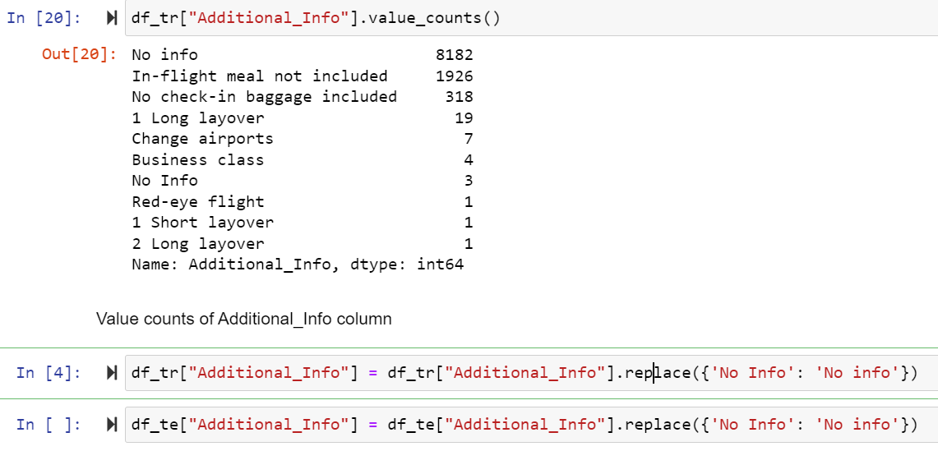
3.Data Preprocessing:
Here in above Train dataset Additional_Info column replace some values name in this column.

Slide 9
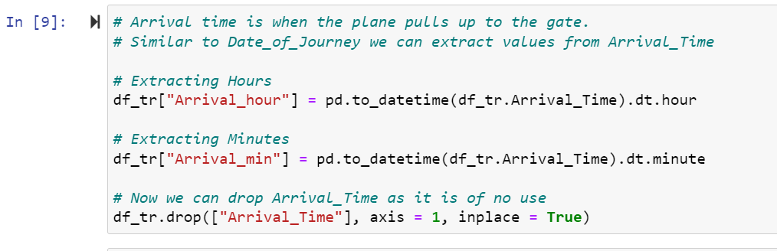
Here in above Train dataset Arrival_Time column in this convert this column into hour and minute.

Slide 10
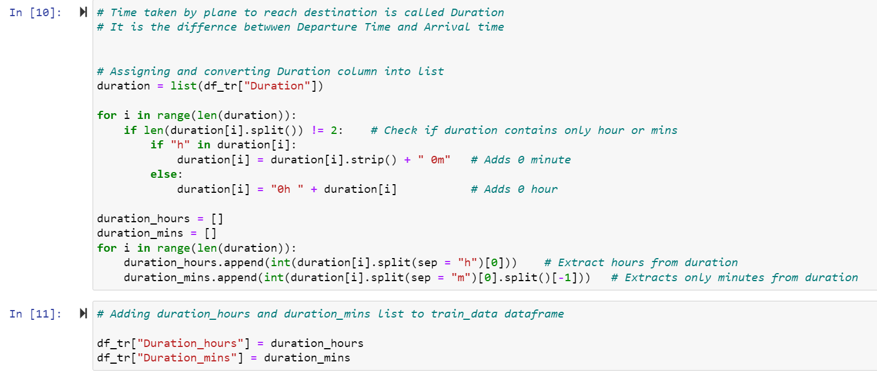
Here in above Train dataset Duration column in this convert this column into hour and minute.

Slide 11
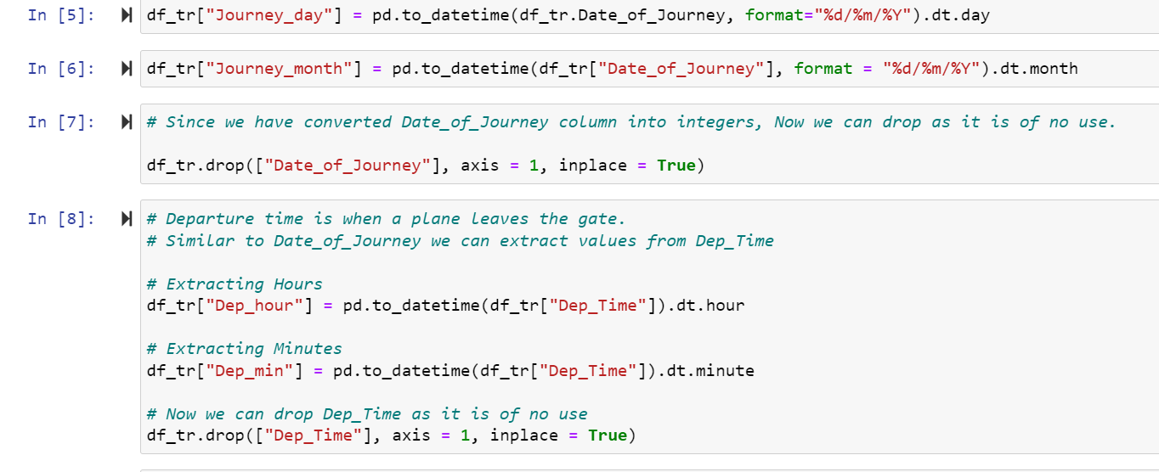
Here in above Train dataset Journey_day and Journey_month columns in this convert this column into hour and minute.

Slide 12
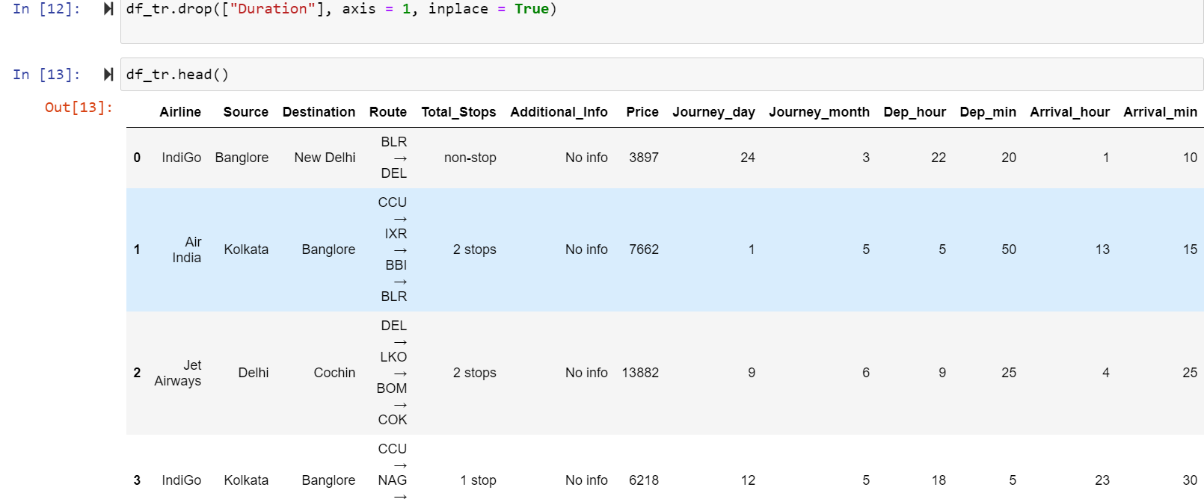
After convert column in train dataset and display the table.

Slide 13
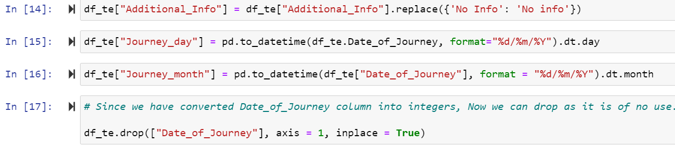
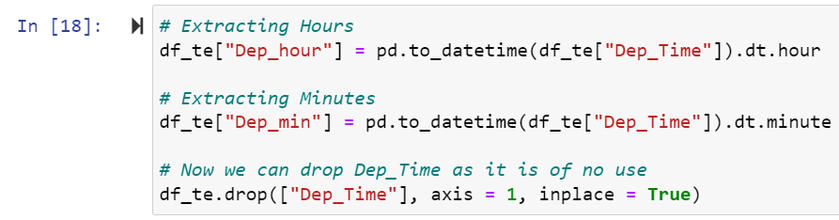
Data Preprocessing on Test DataSet:
Here in above Test dataset Additional_Info column replace some values name in this column.
Here in above Test dataset Journey_day and Journey_month columns in this convert this column into hour and minute.

Slide 14
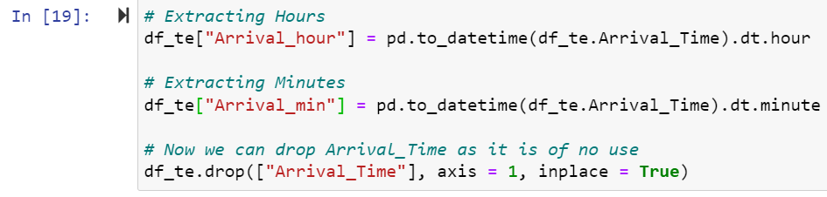
Here in above Test dataset Arrival_Time column in this convert this column into hour and minute.

Slide 15
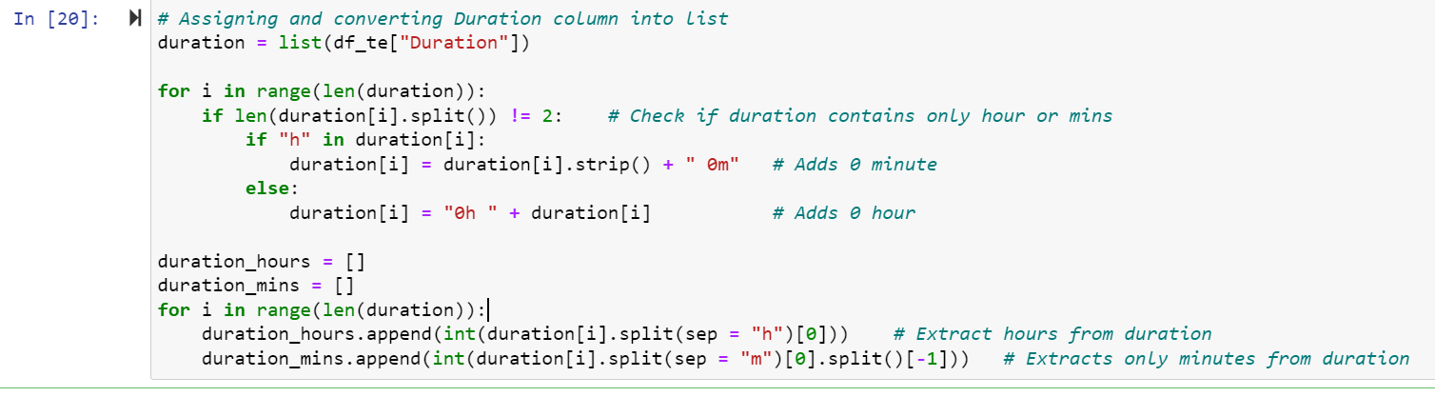
Here in above Train dataset Duration c olumn in this convert this column into hour and minute.

Slide 16
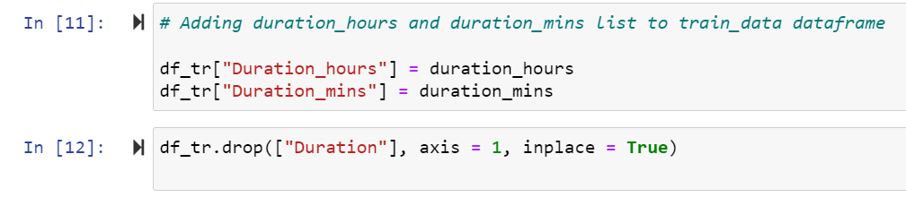
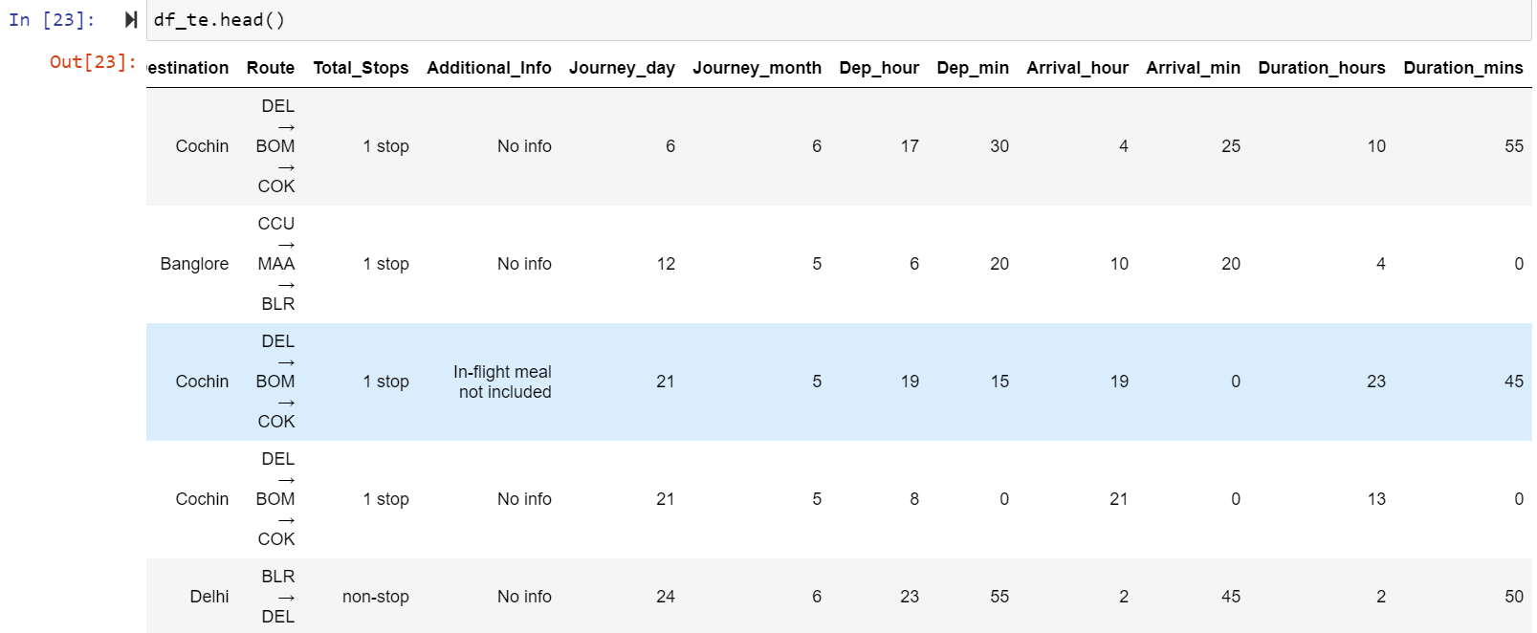
After convert column in test dataset and display the table.

Slide 17
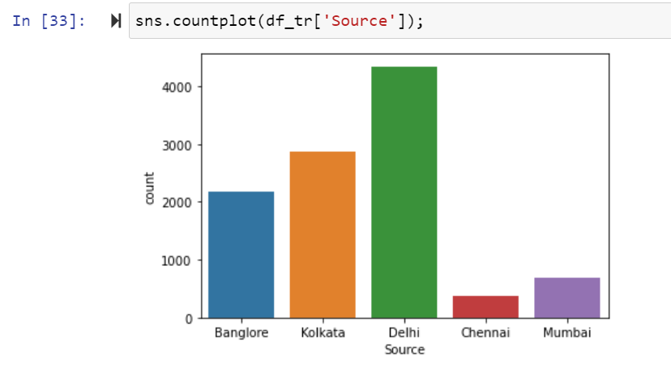
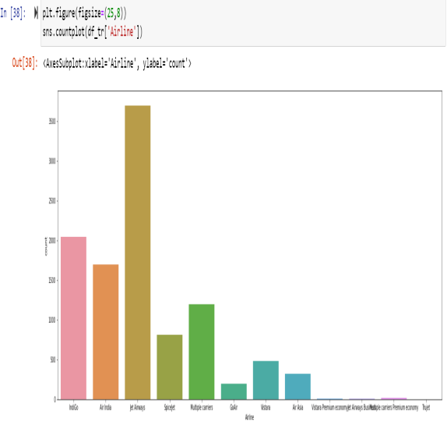
4. EDA:
Univarient Analysis of Train Dataset:
Univarient analysis of ‘Source’ and ‘Airline’ column in train dataset.

Slide 18
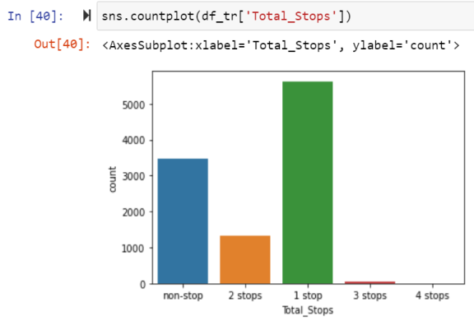
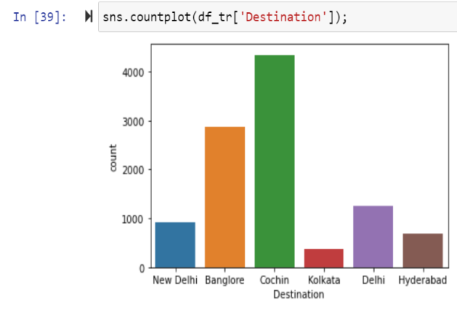
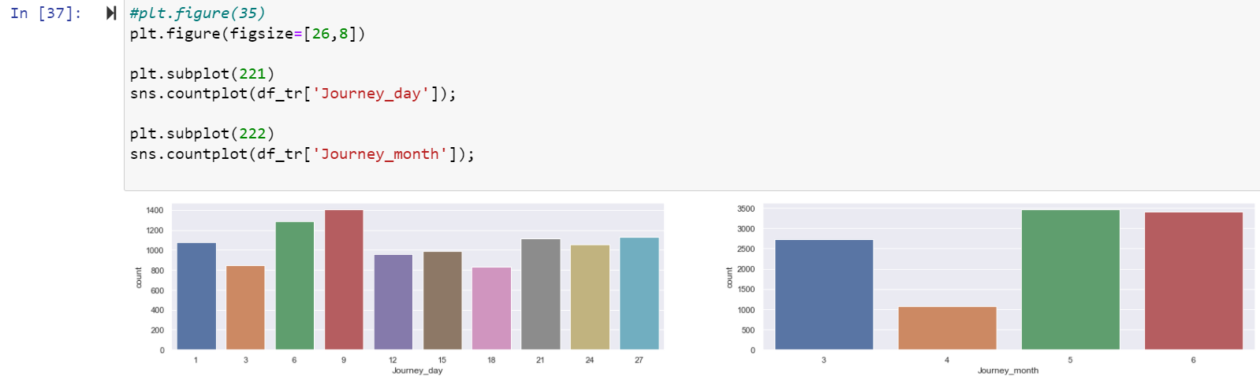
Univarient analysis of ‘Total_Stops’ and ‘Destination’ column in train dataset.
Univarient analysis of ‘Journey_day’ and ‘Journey_month’ column in train dataset.

Slide 19
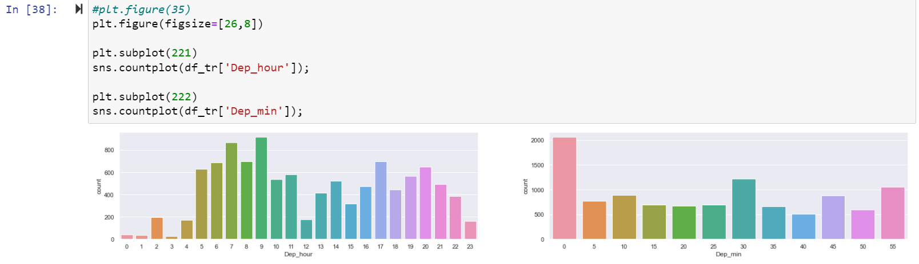
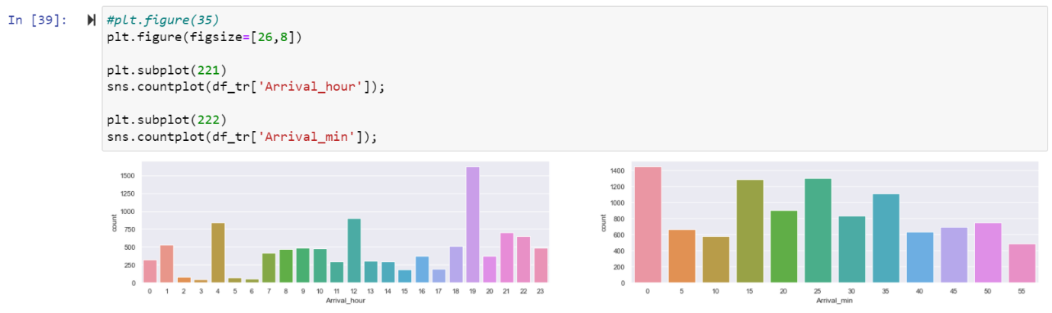
Univarient analysis of ‘Dep_hour’ and ‘Dep-min’ column in train dataset.
Univarient analysis of ‘Arrival_hour’ and ‘Arrival_min’ column in train dataset.

Slide 20
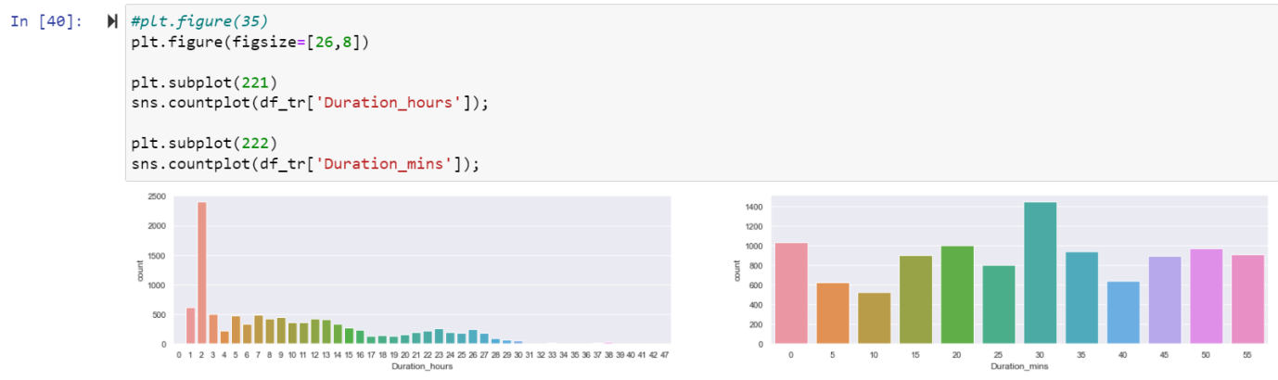
Univarient analysis of ‘Duration_hours’ and ‘Duration-min’ column in train dataset.

Slide 21
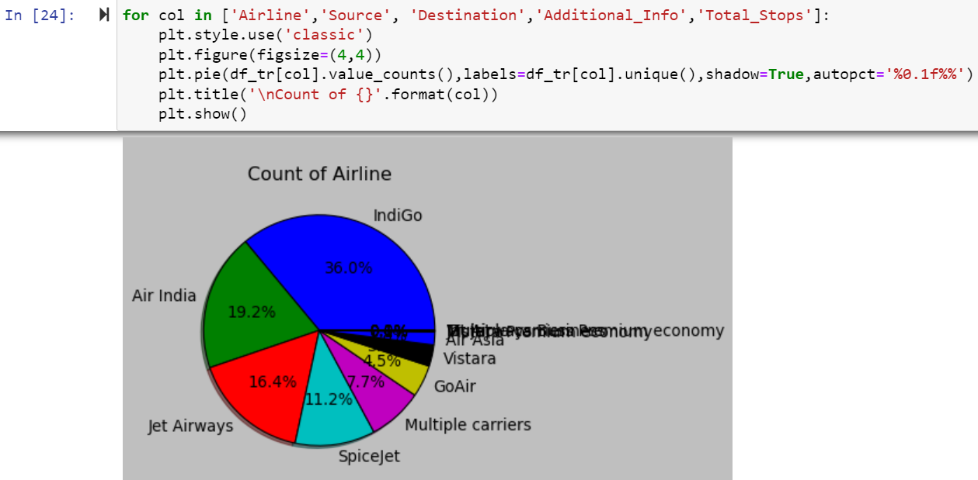
Here pie plot of four columns in Train dataset.

Slide 22
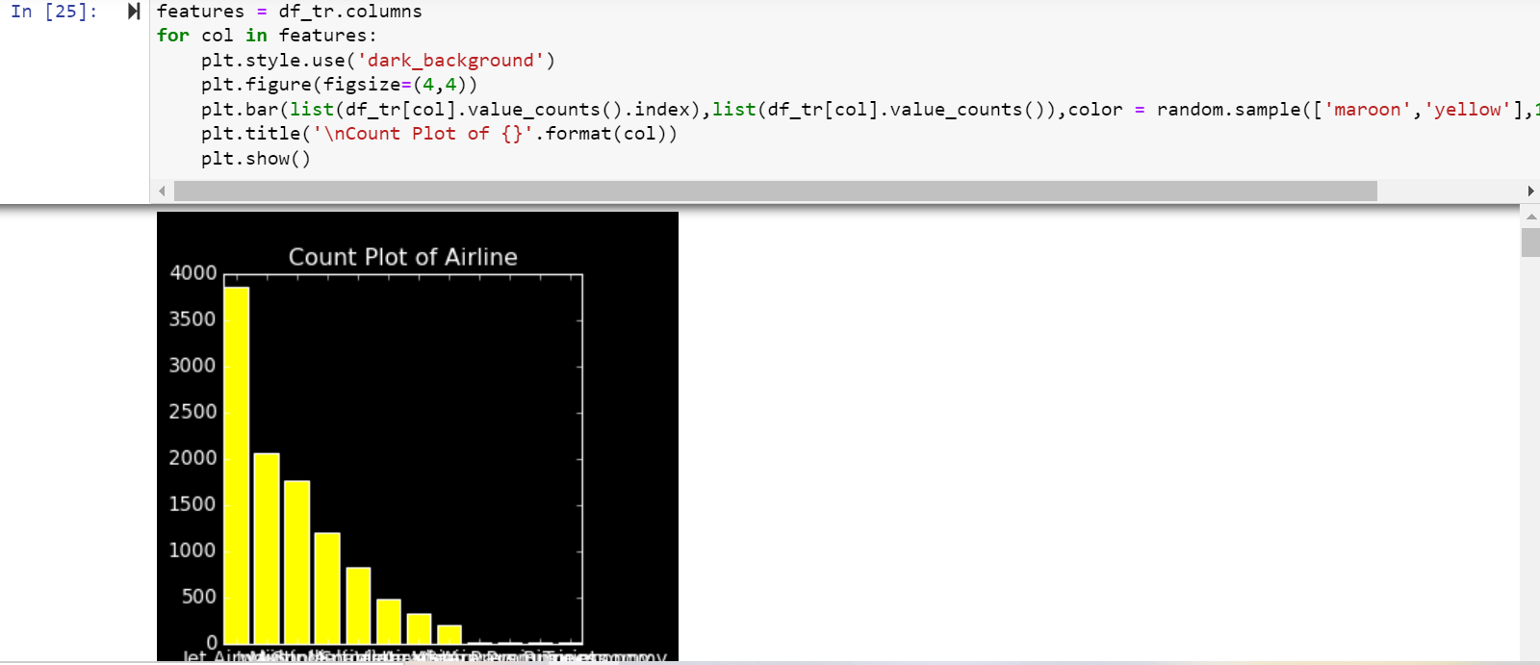
Here barplot of the columns in Train Dataset.

Slide 23
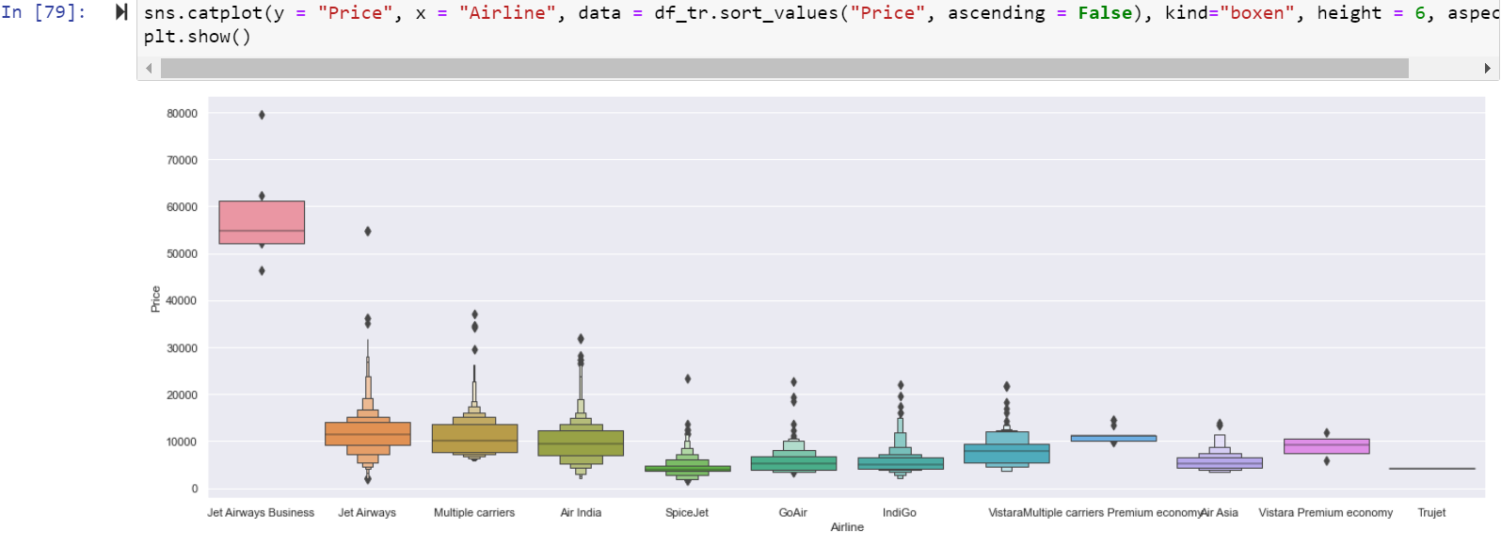
Here above are the plot the target variable Price with the Airline columns and above is the conclusion is Jet Airways Business flight and Jet Airways is expensive than the Indigo and other flights.

Slide 24
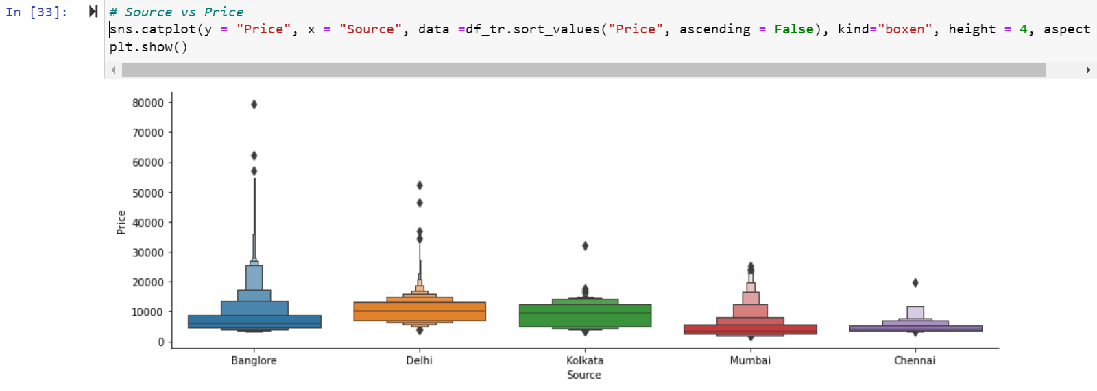
Here above are the plot the target variable Price with the Source columns and above is the conclusion is Bangalore flight is expensive than the other flights.

Slide 25
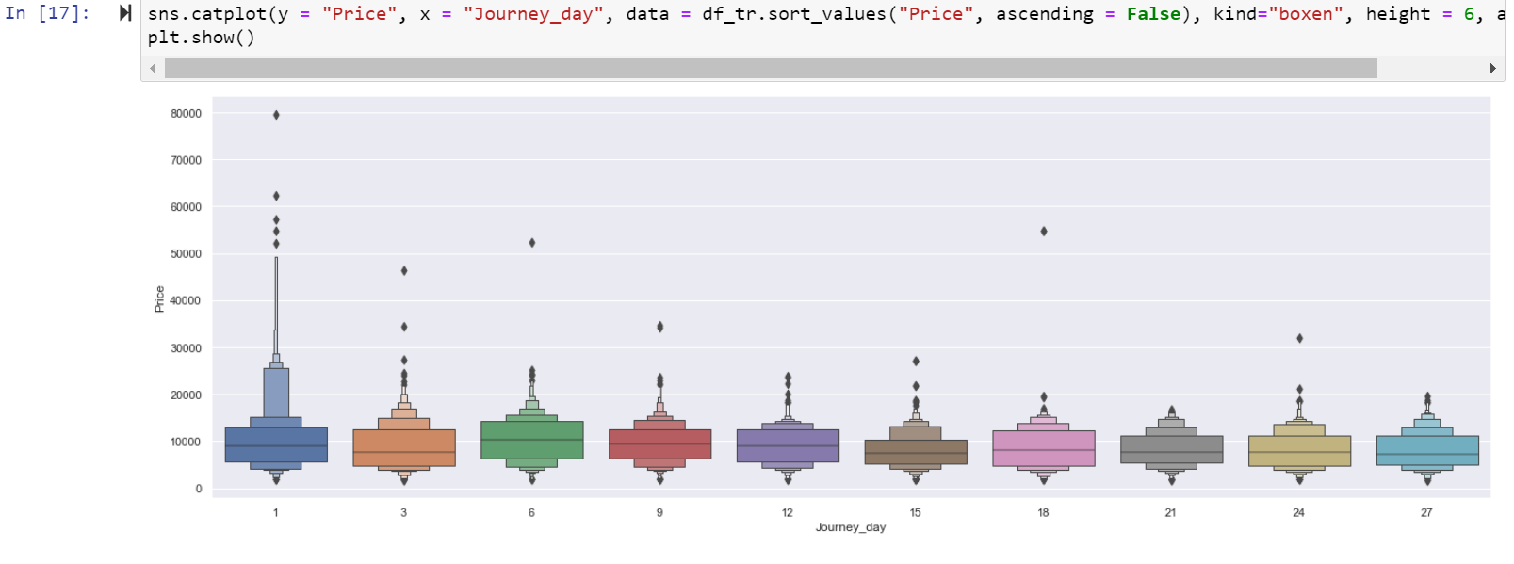
Here above are the plot the target variable Price with the Journey_day columns and above is the conclusion is day 1 flight is expensive than the other flights.

Slide 26
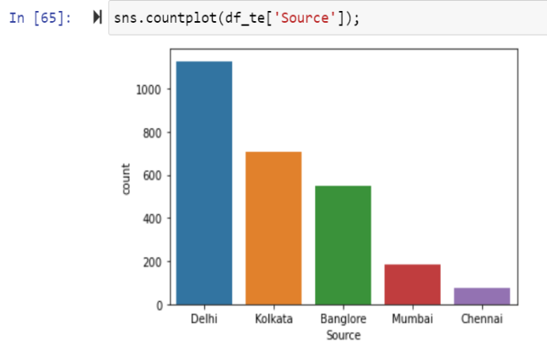
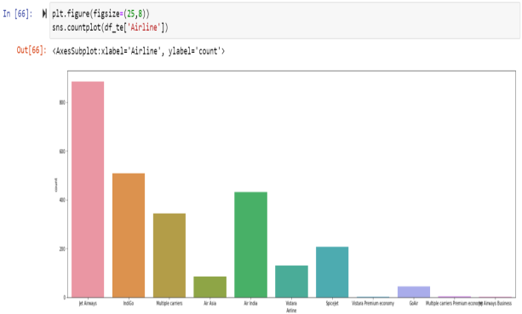
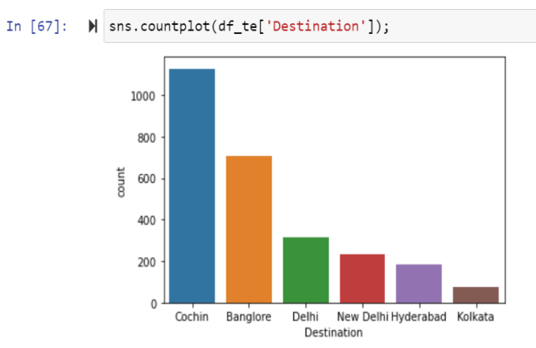
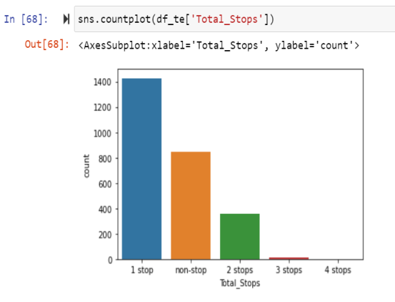
Univarient Analysis of Test dataset:
Univarient analysis of ‘Destination’ and ‘Total_Stops’ ,Source , Airline column

Slide 27
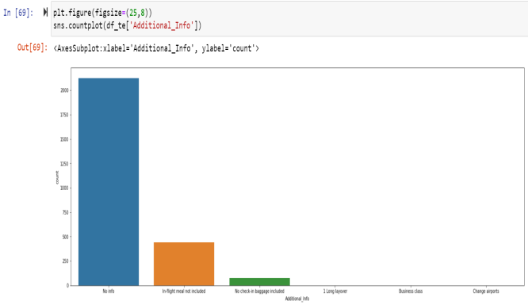
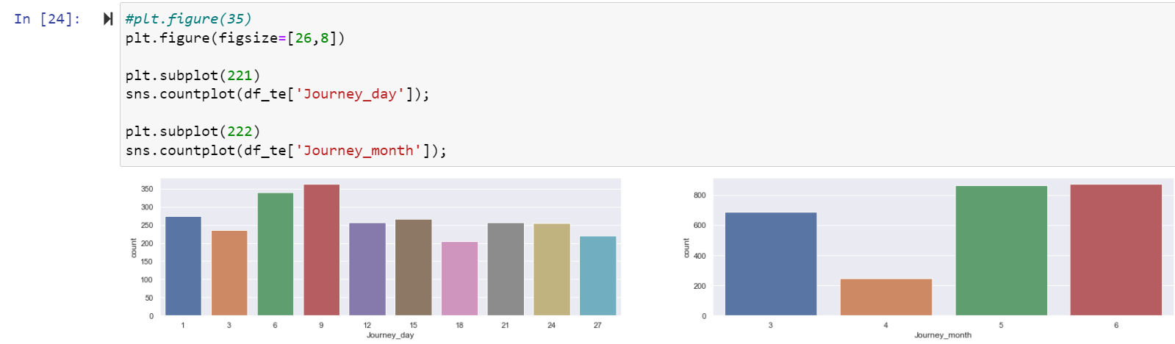
Univarient analysis of ‘Additional_Info’ column
Univarient analysis of ‘Journey_day’ and ‘Journey_month’ column.

Slide 28
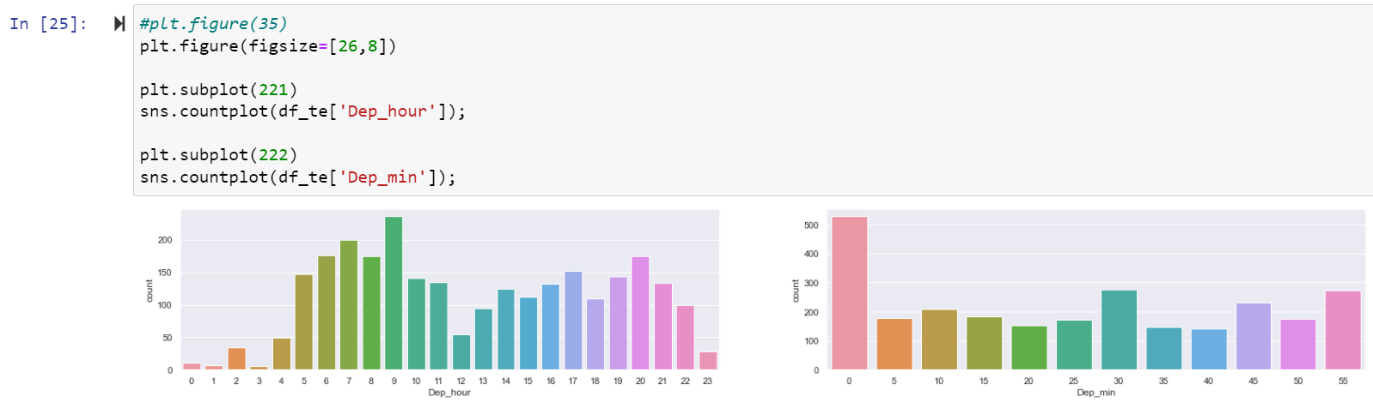
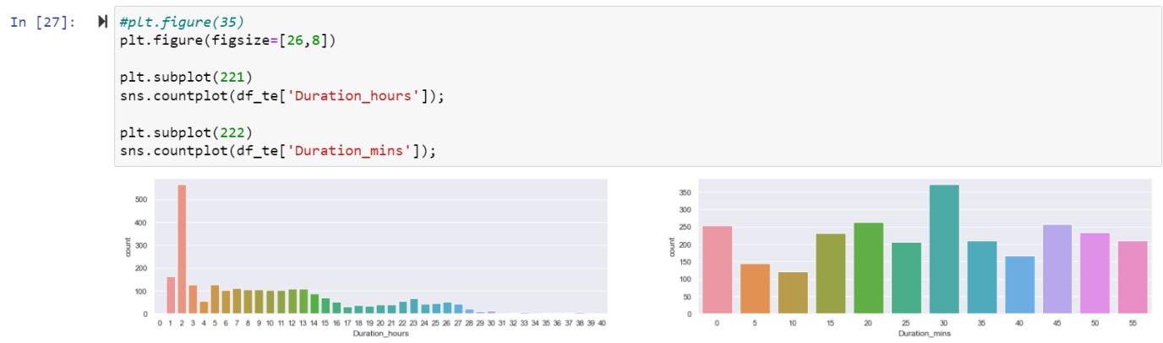
Univarient analysis of ‘Dep_hour’ and ‘Dep-min’
Univarient analysis of ‘Duration_hours’ and ‘Duration-min’ column

Slide 29
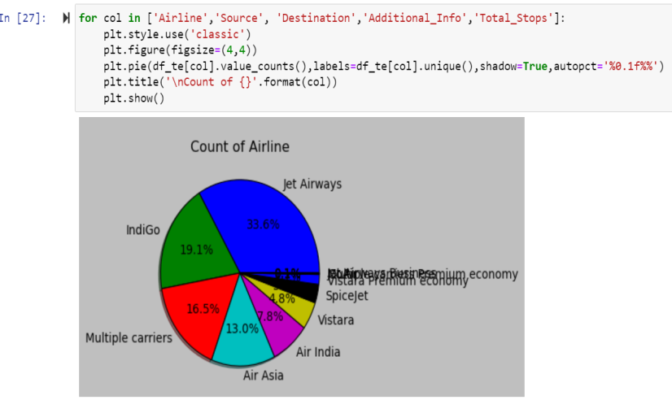
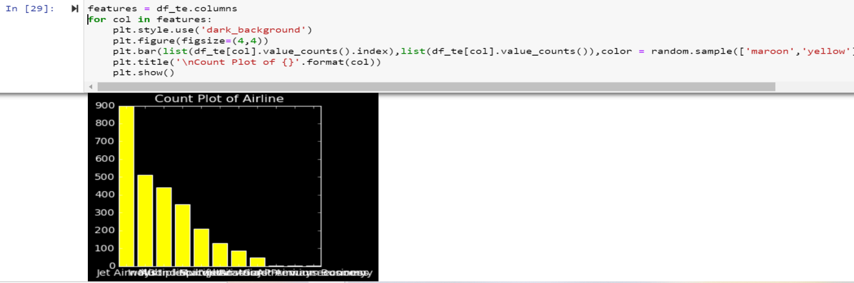
Here pie plot of four columns in Test dataset.
Here barplot of the columns in Test Dataset.

Slide 30
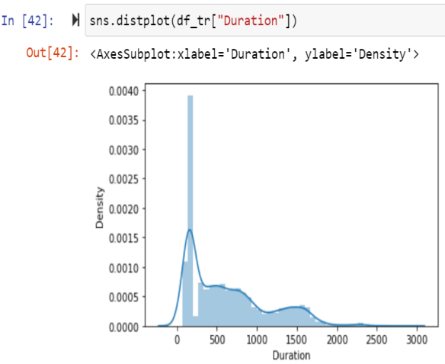
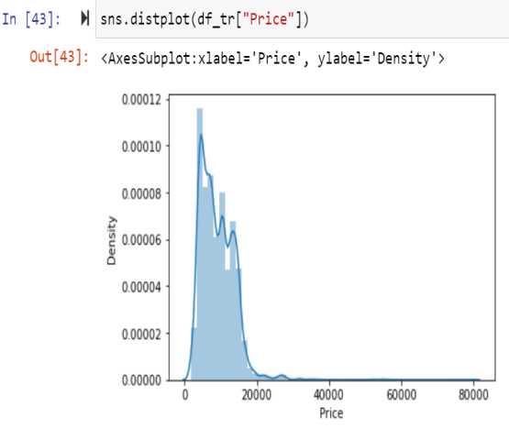
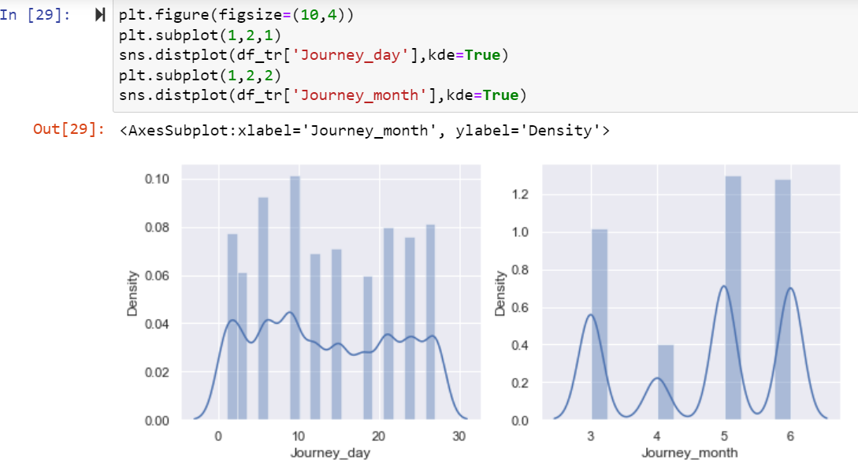
Checking Distribution of Train Dataset:

Slide 31
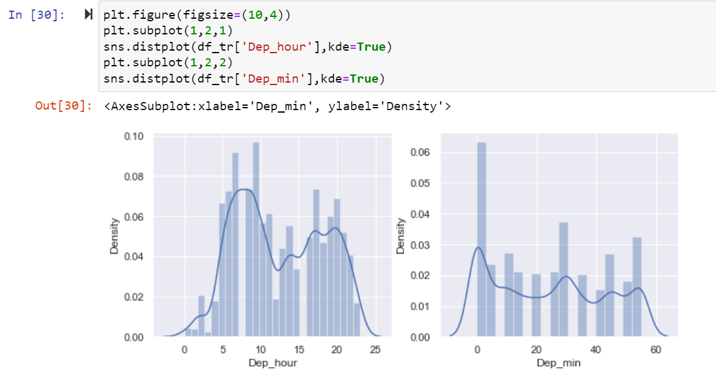
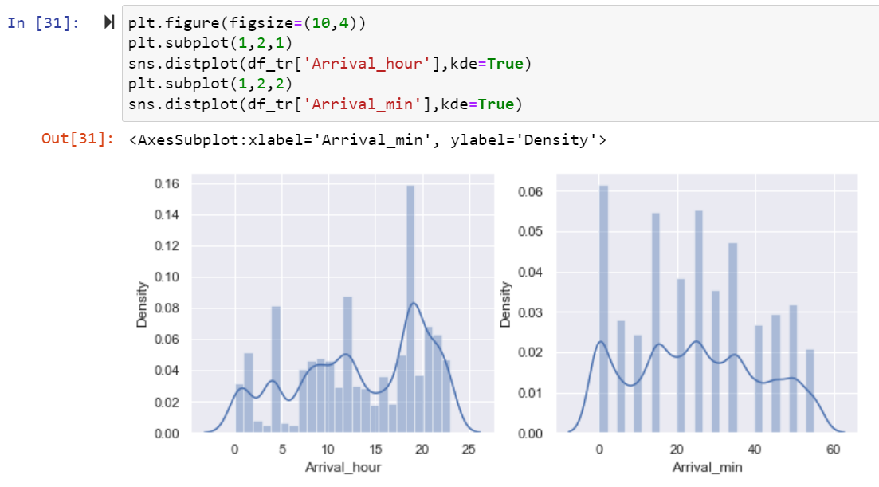
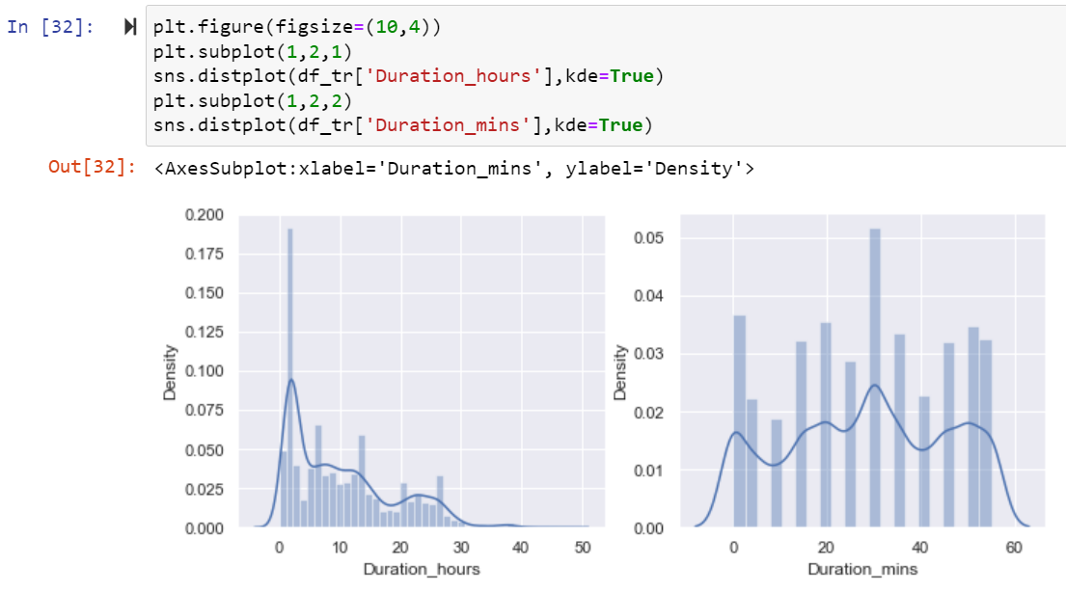

Slide 32
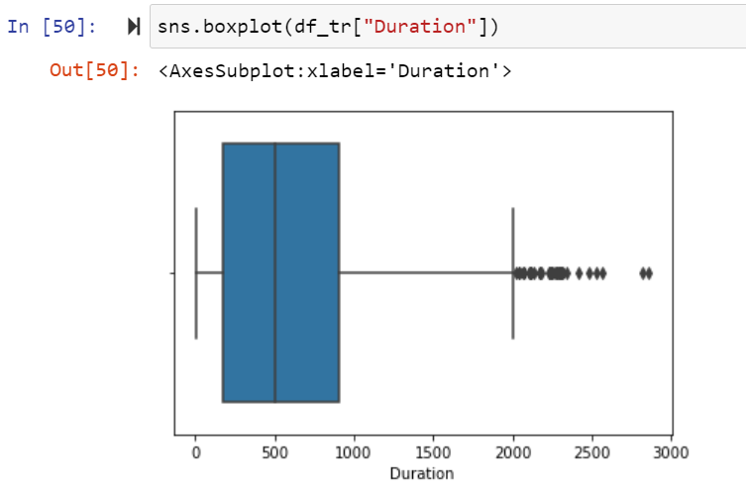
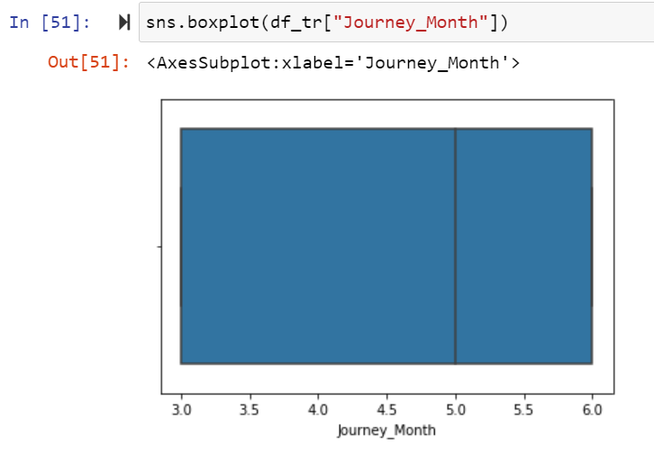





Checking Outliers of Train Dataset:

Slide 33



Here no outliers are present in Train dataset.

Slide 34



Checking Distribution of Test Dataset:

Slide 35


Here data some column is normally distributed and some column are not normally distributed.

Slide 36







Checking Outliers of Test Dataset:

Slide 37


Bi varient Analysis of Train Dataset:

Slide 38



Slide 39


Here Above Scatterplot shows the comparision between two columns In which hue Target column Train Dataset.

Slide 40


Bi varient Analysis of Test Dataset:

Slide 41



Slide 42



Slide 43


Here Above Scatterplot shows the comparision between two columns In which hue Target column Test Dataset.

Slide 44

Multi Varient Analysis of Train Dataset:
sns.pairplot(df_tr, hue='Price')

Slide 45

Multi Varient Analysis of Test Dataset:

Slide 46


Here distribution of all columns in Train Dataset.
Here distribution of all columns in Test Dataset.

Slide 47


Data Inputs- Output Logic Relationships
Here Change the values in Total_Stops column in Train and Test Dataset.
Here Check the values in Airline and Additional Info column in Dataset.

Slide 48


Here Change the values in Airline and Additional_Info column in Train and Test Dataset.’
After that display Train dataset.

Slide 49

After that display Test dataset.

Slide 50


Here use label encoder to replace the categorical values into numeric in train dataset and drop the Route column because it is not much important.
Here after converting categorical values into numeric display Train Dataset.

Slide 51


Here use label encoder to replace the categorical values into numeric in Test dataset and drop the Route column because it is not much important.
Here after converting categorical values into numeric display Test Dataset.

Slide 52

Correlation:
Heatmap of Train Dataset:
cor=df_tr.corr()
cor
After that Checking Correlation of all independent columns with Target column.

Slide 53

plt.figure(figsize=(15,10))
sns.heatmap(df_tr.corr(),annot=True)
Heat map shows the correlation of every independent variable in dataset with target variable. Here above heatmap the every independent variable check correlation with Price target variable.

Slide 54

plt.figure(figsize=(15,10))
df_tr.corr()['Price'].sort_values(ascending=False).drop(['Price']).plot(kind='bar',color='c')
plt.xlabel('Feature',fontsize=14)
plt.ylabel('column with target names',fontsize=14)
plt.title('correlation',fontsize=18)
plt.show()
Here we shows the correlation in another way in this above we show some columns are positively and some columns are negatively correlated with target variable.

Slide 55

Heatmap of Test Dataset:
cor=df_te.corr()
cor
After that Checking Correlation of all independent columns in Test Dataset.

Slide 56

plt.figure(figsize=(15,10))
sns.heatmap(df_tr.corr(),annot=True)
Heat map shows the correlation of every independent variable in dataset with target variable. Here above heatmap the every independent variable check correlation.

Slide 57

Use zScore Check the dataloss:
After that Cheking Data loss of the dataset after using preprocessing steps here using zscore method checking dataloss here after zscore there 1.89 is dataloss.

Slide 58

Use IQR Check the dataloss:
Here After Applying IQR method checking dataloss here using IQR method more dataloss.

Slide 59


Checking Skewness:
To remove skewness use PowerTransformer technique in dataset.

Slide 60

Min Max Scaler Technique:

Slide 61

5.Building Machine Learning Models:
Lasso Regression:

Slide 62


Here r2 score is 0.41 for train dataset and 0.45 for test dataset and cross validation score is 0.44 in Lasso algorithm

Slide 63


Ridge Regression:
Here r2 score is 0.41 for train dataset and 0.45 for test dataset and cross validation score is 0.44 in Ridge algorithm.

Slide 64

RandomForest Regression:
Here r2 score is 0.90 for train dataset and 0.97 for test dataset and cross validation score is 0.87 in RandomForestRegressor algorithm.

Slide 65

SVR Regression:
Here r2 score is 0.003 for train dataset and 0.011 test dataset and cross validation score is 1.01 SVR algorithm.

Slide 66

DecisionTreeRegressor:
Here r2 score is 0.85 for train dataset and 0.99 for test dataset and cross validation score is 79 in DecisionTreeRegressor algorithm

Slide 67

AdaBoostRegressor:
Here r2 score is 0.47 for train dataset and 0.47 for test dataset and cross validation score is 79 in AdaBoostRegressor algorithm.

Slide 68

KNN Regressor:
Here r2 score is 0.75 for train dataset and 0.84 for test dataset and cross validation score is 79 in KNN Regressor algorithm.

Slide 69

GradientBoostingRegressor:
Here r2 score is 0.83 for train dataset and 0.83 for test dataset and cross validation score is 79 in GradientBoostRegressor algorithm

Slide 70

GridSearchCv:
Here above are the parameter list of RandomForestRegressor model.
The above code block we have the following parameters max_features: In this maximum features there are two values auto and auto,sqrt.
criterion is mse ,mae

Slide 71


Slide 72

Here after use different parameter list the best parameter list is select. Above are the best parameter list RandomForestRegressor. Put this parameters into the model so output is finally best score os RandomForestRegressor is 87 so it is the best score

Slide 73



Slide 74

Finally Load the model and predict the values.

Slide 75
6.Conclusion
A proper implementation of this project can result in saving money of inexperienced people by providing them the information related to trends that flight prices follow and also give them a predicted value of the price which they use to decide whether to book ticket now or later. In conclusion this type of service can be implemented with good accuracy of prediction. As the predicted value is not fully accurate there is huge scope for improvement of these kind of service.

